Slide 1

Immunization (IZ) Validation Tool
Quick Guide
Robert Snelick
Sandra Martinez
National Institute of Standards and Technology
December 7th, 2012
Contact: rsnelick@nist.gov

Slide 2
http://hl7v2-iz-testing.nist.gov
Immunization Validation Tool Overview
  Purpose: The tool validates Immunization messages created by Electronic Health Records (EHR) technology and is intended for certifying 2014 Edition Meaningful Use EHR technology.
Tool Key Capabilities
Context-free Testing | (No Test Cases - Test any Immunization message created by EHR) Context is unknown to validation tool Provides a simple and convenient method for testing message structure and most vocabulary
Context-based Testing | (Test Cases - Test Immunization message associated with a specific test scenario) Context is known to validation tool All conformance requirements of the Immunization implementation guide can be assessed Used for certifying 2014 Edition Meaningful Use EHR technology
Profile Viewer | Provides a browsable version of the conformance profile which encapsulates the requirements. Can be used to assist in the interpretation of errors.
Vocabulary Browser | Provides a browsable view of the vocabulary requirements. Can be used to assist in the interpretation of value set errors.
Documentation | Provides access to documents which will assist in using the tool (including test procedure, test cases, profile descriptions, vocabulary descriptions and validation tool download).
  Get started today! No registration or log in credentials are needed. Simply click link on the link below and send/paste/load message into tool to obtain Validation report.
  NOTE: The Test Tool (.war file) can also be downloaded and installed locally.
  NOTE: Web Application is compatible with Firefox; Chrome; IE8; IE9
  More Info? Register to Google Group at: http://groups.google.com/group/hl7v2-immunization-testing to ask questions and provide feedback.

Slide 3
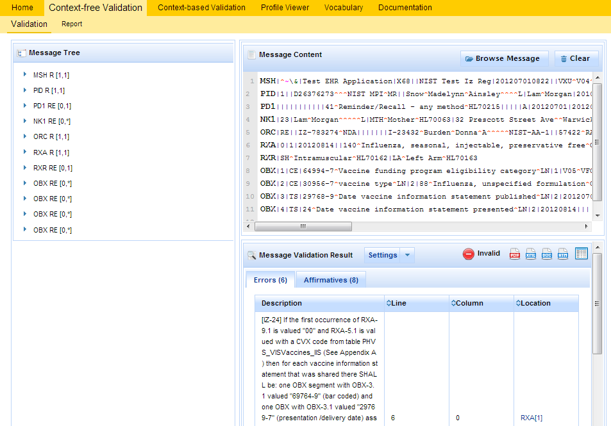
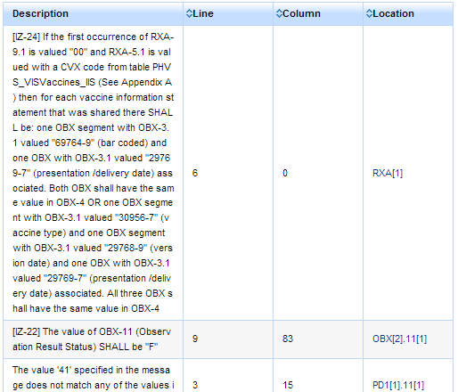
Immunization Context-free Testing (No Test Case)
1
Open Immunization Validation tool using link: http://hl7v2-iz-testing.nist.gov and click on Context-free Validation tab.
Context-free Validation page
This page validates any Immunization message created by the EHR. It is disassociated from a test script, test case, or specific content (test data).
2
Copy/paste or click on Browse Message button to upload test message into Message Content window.
3
Validation results appear. If message failed, errors display.
4
Click on Report Details icon to display Message Validation Report.
5
Review Message Validation Results to determine what caused the errors.

Slide 4
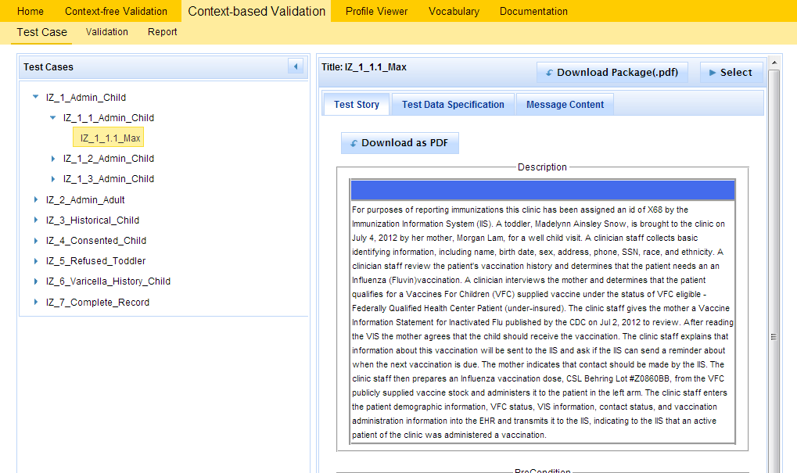
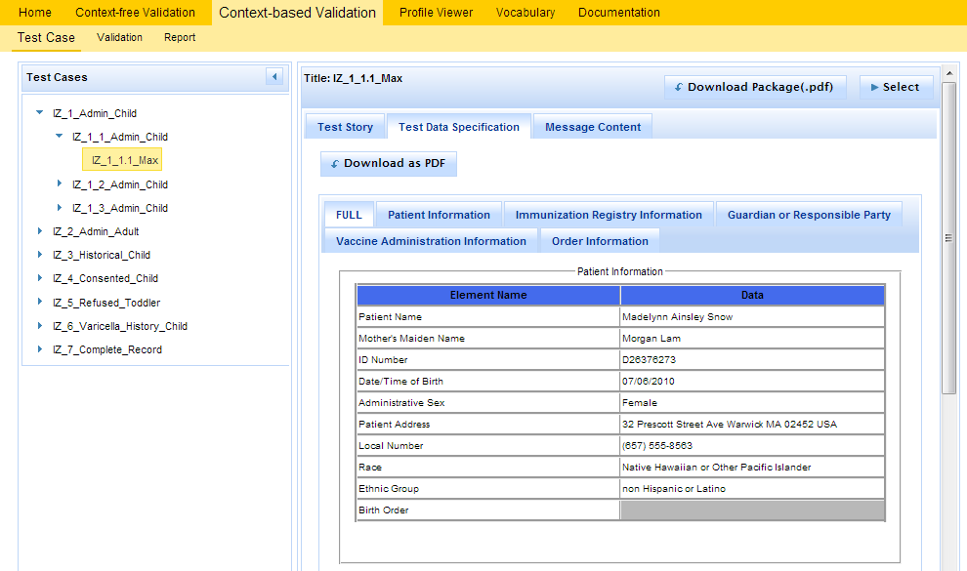
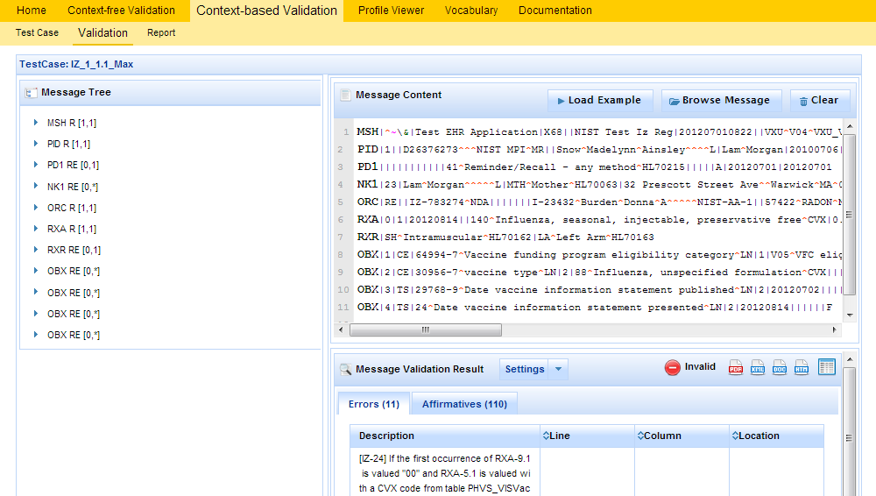
Immunization Context-based Testing (Using Test Cases)
1
Context-based Validation page
This page validates messages associated with a given test script that includes a specific Immunization test scenario. Testing will include the technical requirements and content-specific requirements specified in the Test Case.
Open Immunization Validation tool using link: http://hl7v2-iz-testing.nist.gov and click on Context-based Validation tab.
2
Expand the first Test Scenario. Select and expand a Test Case, then select Test Step.
4
3
Click on Test Data Specification tab.
Review Test Story.
5
Relevant real-world clinical data is displayed.
6
Create the test message with the EHR technology using the test data provided.
8
7
Copy/paste or click on Browse Message button to upload test message into Message Content window.
Click on Select button to load Test Step.
9
10
Validation results appear. If message failed, errors display.
Click on Report Details icon to display Message Validation Report.
11
Review Message Validation Results to determine what caused the errors.

Slide 5
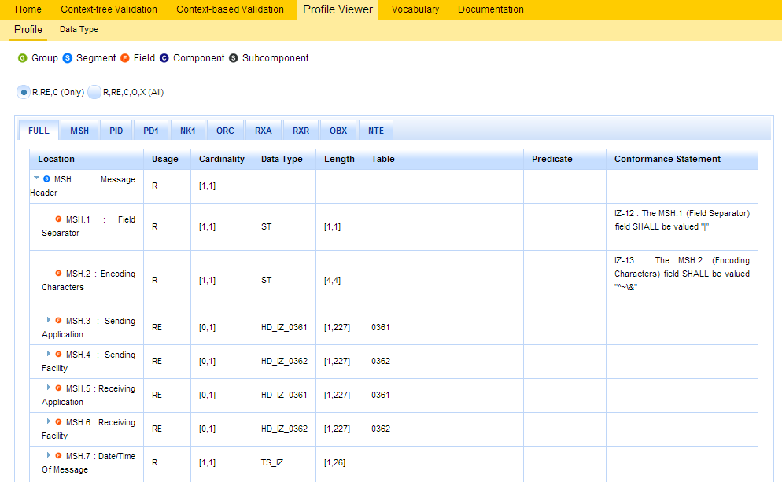
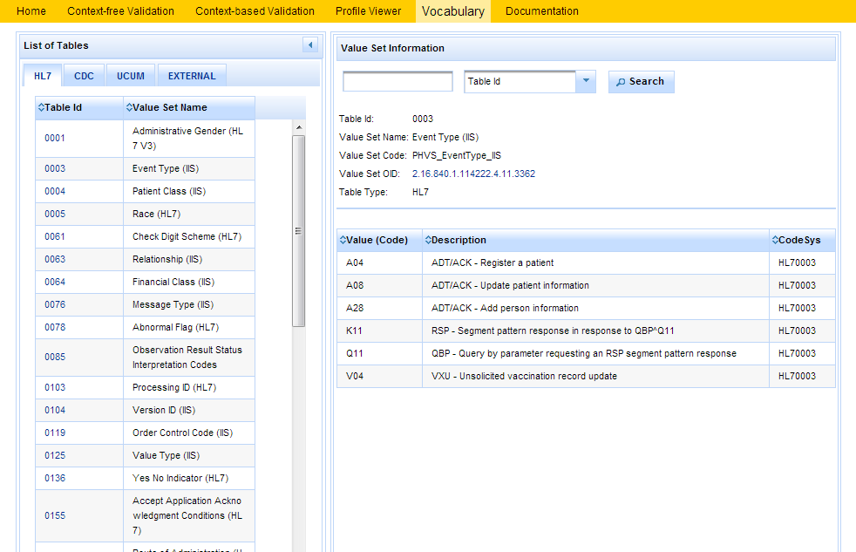
Other Utilities
Profile Viewer page
This page allows tester to view data element information including usage, cardinality, data type, length, table, condition predicate and conformance statements.
Vocabulary page
This page provides the ability to browse the vocabulary requirements. Search capabilities are provided and include searching on value, table name, table ID and description.

Slide 6
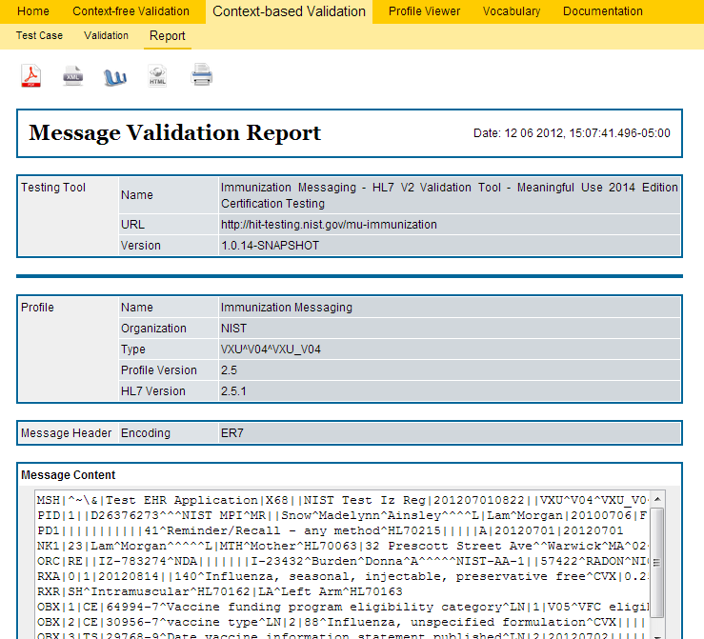
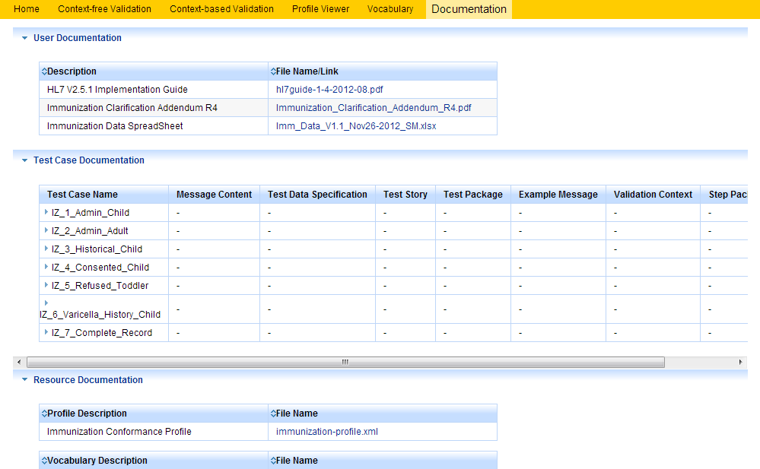
Other Utilities
Message Validation Report
The Message Validation Report is the output of the Immunization Test Tool. This report states if the test message has passed or failed the test and identifies the points of failure.
Documentation page
The Documentation page provides the ability to download all documents and files for testing, including Test Procedure, Test Cases, Profile and Vocabulary Description files, and validation tool application file (.war file).
1
Message Validation Report may be downloaded as a PDF, XML, Word or HTML file.
2
Message Validation Report may be printed.

